Slide 1
Class 16: Classification and Regression Trees (CART)
MGSC 310
Ben Labaschin

Slide 2
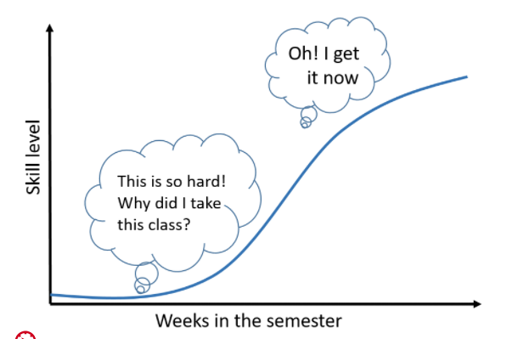

Welcome to the Easier Part of the Course

Slide 3
Class 16: Outline
Regression and Classification Trees
Regression and Classification Trees in Python
Regression and Classification Trees Lab

Slide 4
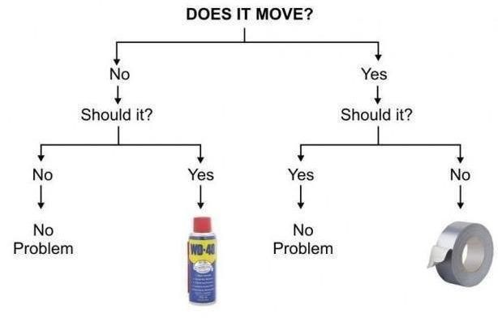
What Are Binary Decision Rules?
Binary decision rules are any rules with only two options!

Slide 5
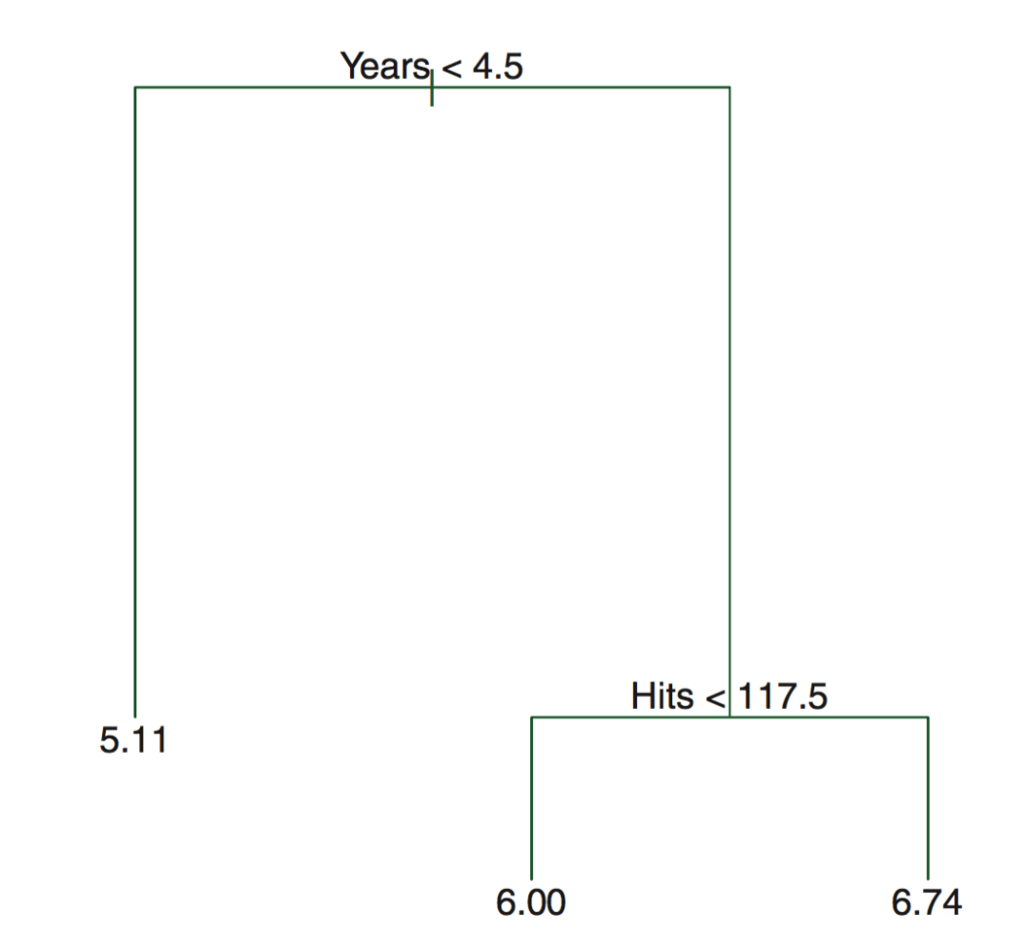
Classification and Regression Trees
Tree based methods stratify or segment the predictor space into different regions
Regions are stratified via simple rules
The splitting rules can be summarized into a tree that is very intuitive

Slide 6
Pros and Cons of Trees
Pros
Simple
Easy to interpret
Easy to explain
Can be displayed graphically!
Bagging, boosting, and random forests very powerful (combining trees)
Cons
Slow with large datasets
Not easy to use “out of the box”
Choice of split can be unstable
Perfectly fine to start with a random (boosted) forest!

Slide 7
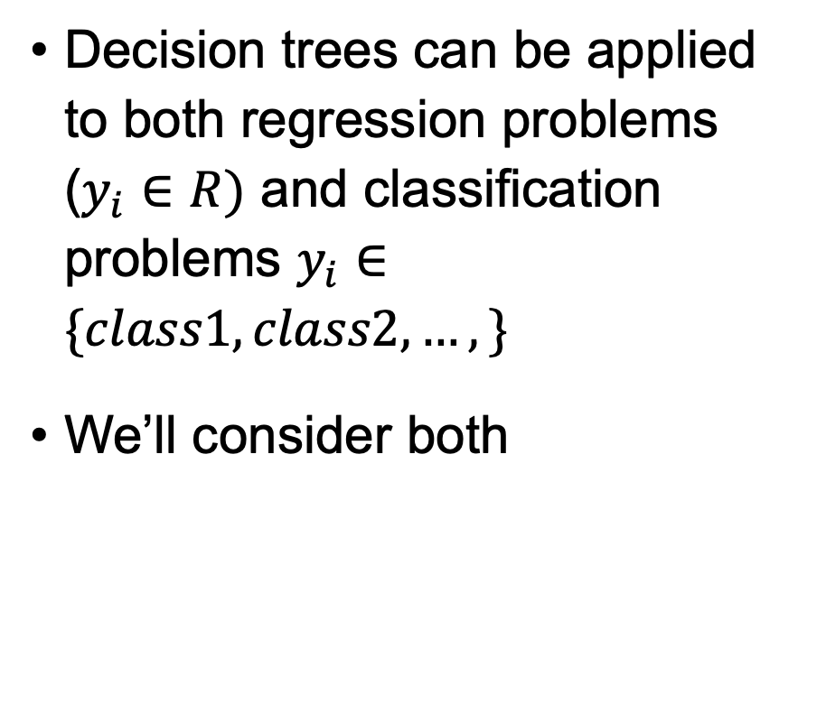
CART Trees

Slide 8
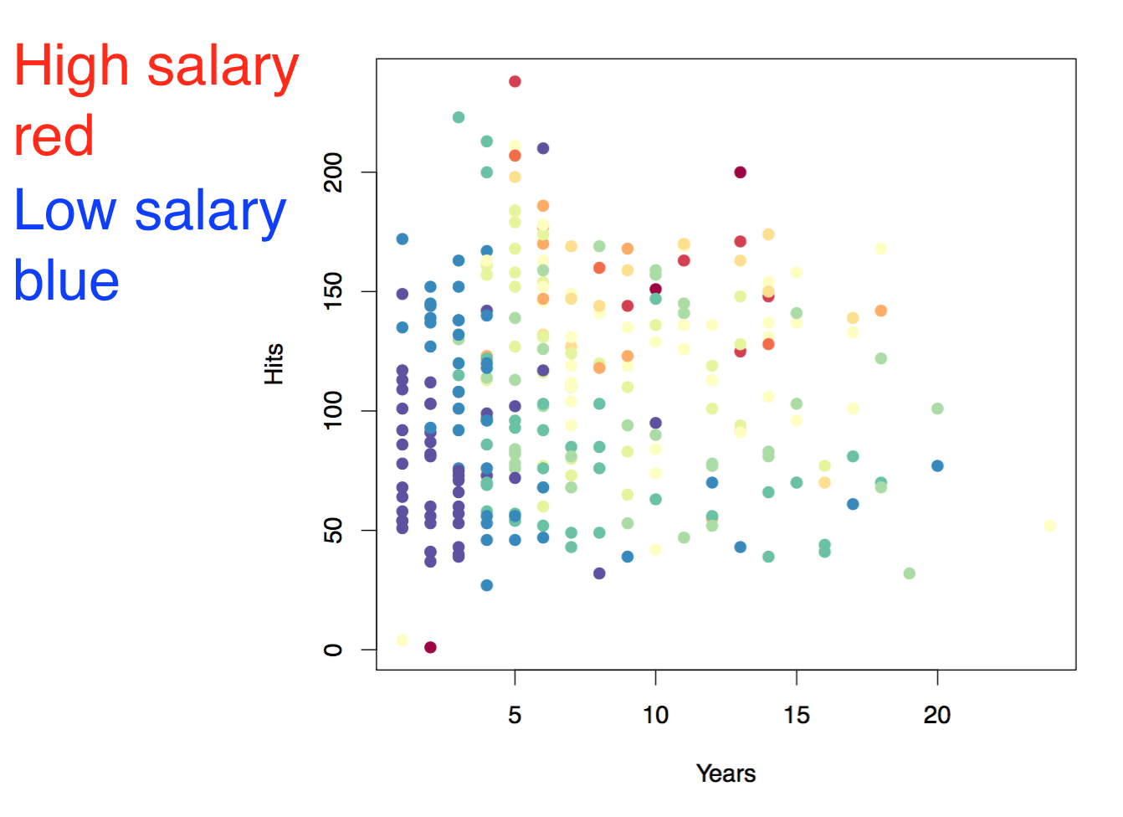
Baseball salary data: how to partition/stratify?

Slide 9
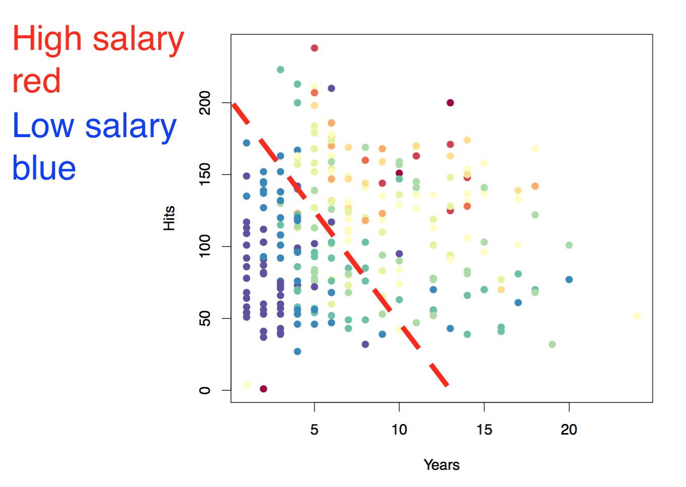
Baseball salary data: how to partition/stratify?

Slide 10
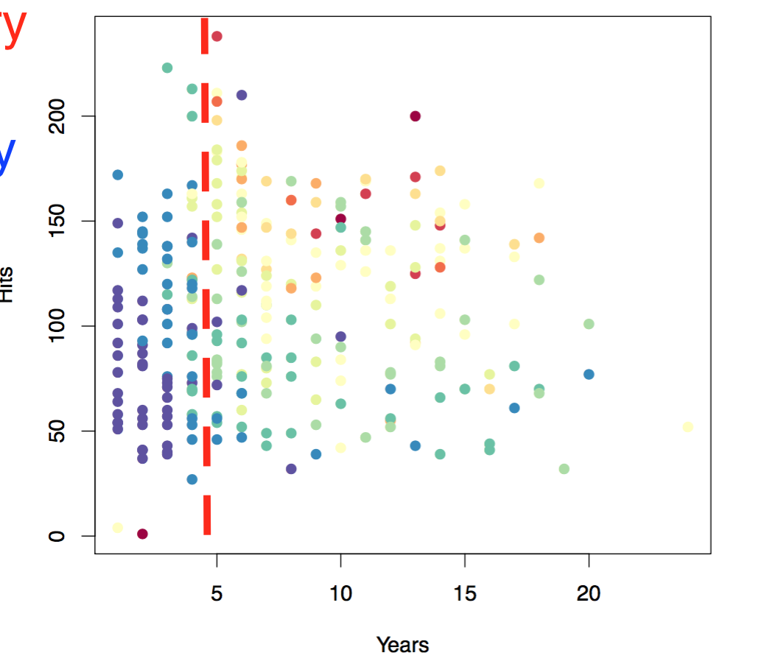
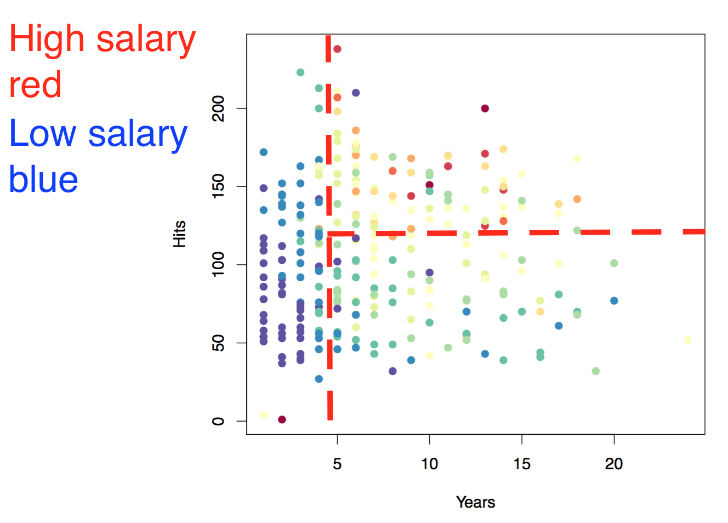
Constructing CART Trees: Greedy Search
CART trees are constructed via a greedy search algorithm
Starting at the root (top) node, the algorithm tries every possible binary split for every variable.
The variable and split that maximizes the separation of classes (or minimizes within cluster variance for regression) is chosen for the root node. (here years > 4.5)
Given the split at the root node, the algorithm then tries every possible binary split for every possible variable. The variable and split that minimizes the loss function is chosen for that node. (hits > 117.5)
This process is repeated until some stopping criteria is reached (usually maximum tree depth or minimum number of observations in a leaf)

Slide 11

Tree Representation of Split Choices
Split 1: years > 4.5
Split 2: hits > 117.5

Slide 12
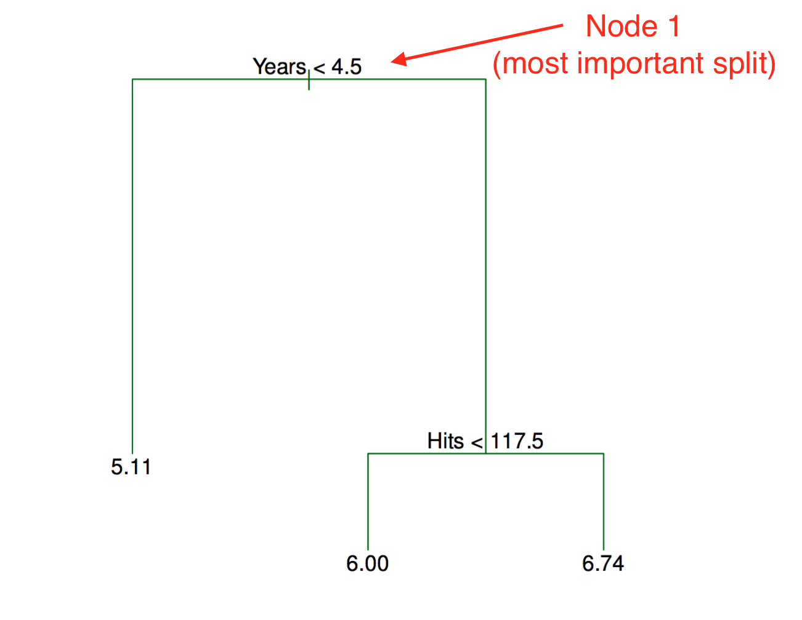
Tree Representation
Trees are read top-down
Most important split is at top
Length represents how much within-cluster variance decreases from split
So Years explains more variance than Hits for this tree

Slide 13
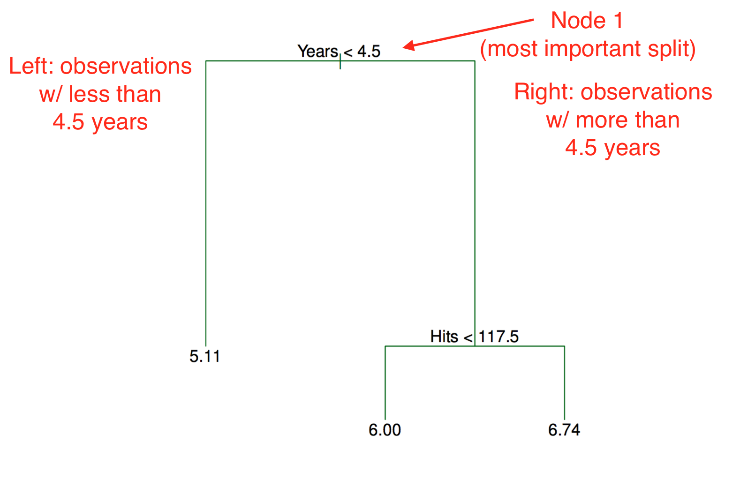
Tree Representation

Slide 14
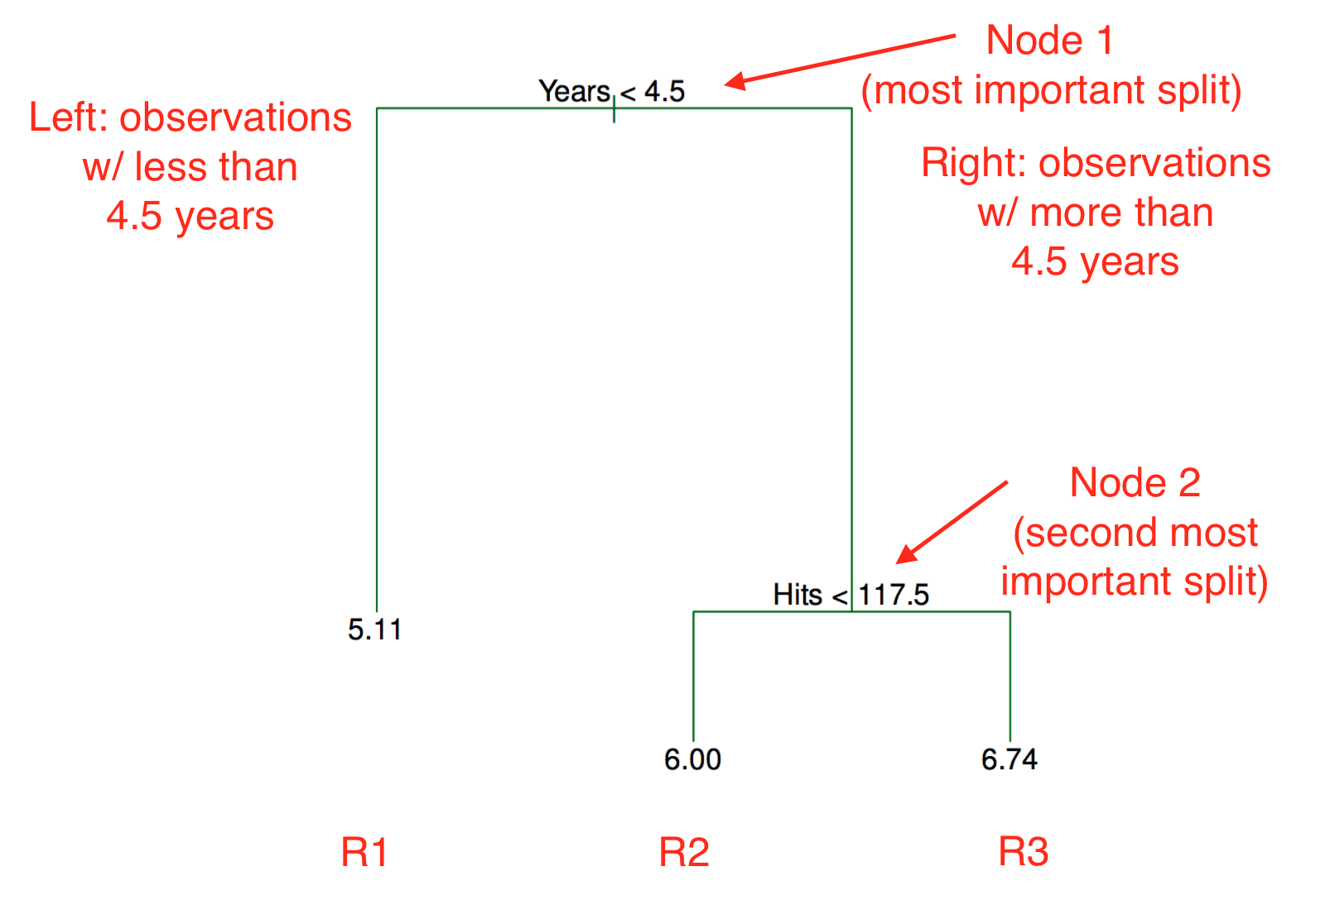
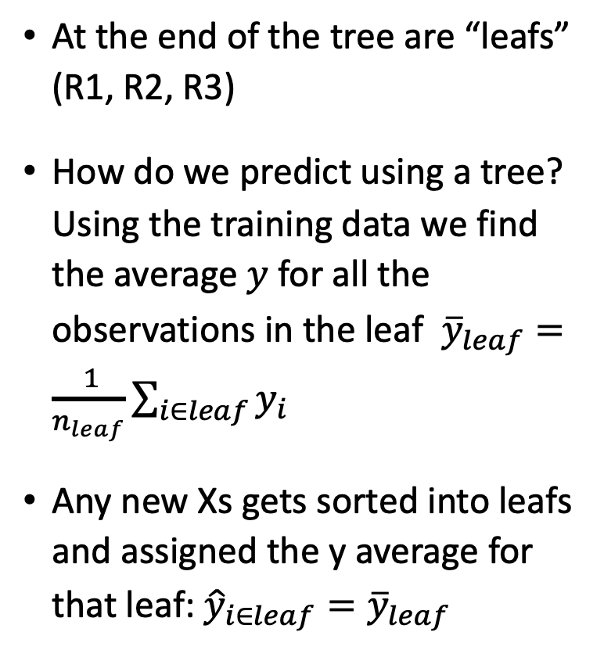
Predictions for Trees? “Leaf” Values

Slide 15

Predictions for Trees? “Leaf” Values
Leaf predictions are average values in each partition, k

Slide 16
Regression Trees in Python
To the code!

Slide 17
Class 16 Summary
CART uses binary decisions of the X variables to predict the outcome
Regression trees can be used for either regression or classification problems
We must control the depth and/or complexity of a tree or else it is prone to overfitting

